Slide 1
Dosimetry DOELAP Assessor Training Review of Findings
Idaho Falls, ID
September 2024

Slide 2
Example Findings
The Radioanalytical Laboratories Quality Assurance Plan, Attachment 4: "Continuity of Operations", discusses a general plan for backup capabilities. The assessment team recommends that the Division establish written agreements with the backup facilities identified in the continuity plan. Additionally, it is recommended to exercise and document aspects of the continuity plan that involve use of equipment and labs, belonging to other programs at XXX. Implementing these additional steps will strengthen the ability of the radiobioassay programs to sustain critical operations in the event of unexpected loss of equipment or facilities. [4.2(h)].
Within the "Dosimetry Quality Assurance Program Plan", section 4.13 Continuity of Operations discusses a general plan for backup capabilities, but no specific agreements are in place to ensure continuity of operations in the event of loss of service (PM.12, 4.2(h)).
Section 4.2(h), addressing Program Management reads, "A program shall have a documented plan for continuity of operations. This includes service contracts, in-house maintenance, spare parts capabilities, and unexpected loss of key personnel". YYY's radiobioassay programs are currently contracted to GEL and ZZZ with no back-up support in case of loss of these service laboratories. YYY is in the early stages of implementing their continuity of operation plan but does not yet have a formal mechanism (e.g., memorandum of understanding) with any alternate laboratories in place. A formal arrangement with alternate laboratories will be beneficial to the program.
AAA internal dosimetry program has a continuity of operations plan in place for in-vivo operations, however, identification and a documented plan for an alternate back-up for in-vitro operations is an ongoing process (4.2(h)).
Notes:
1 – observation, 2 – concern, 3 – observation, 4 – concern

Slide 3
Continuity of Operations
DOE-STD-1112-2019 4.2(h) A program shall have a documented plan for continuity of operations. This includes service contracts, in-house maintenance, spare parts capabilities, and unexpected loss of key personnel.

Slide 4
Continuity – Some History
EH-0026 1986 4.3.3.3 – Adequate backup equipment or systems for key processing steps should be available for use in the event the primary systems fail. The backup system could be arranging for the services of another DOE-accredited contractor on an emergency basis.
DOE-STD-1112-98 5.6.3 – Adequate backup equipment or systems for key measurement systems should be available for use in case the primary systems fail. Backup systems can either include alternate electronics and instrumentation or an ability to arrange for the services of another DOELAP accredited radiobioassay service laboratory on an emergency basis.
Notes:
The point is, a continuity or backup plan has always been a requirement. DOELAP just was not digging deep into the possibility of the plan actually working.

Slide 5
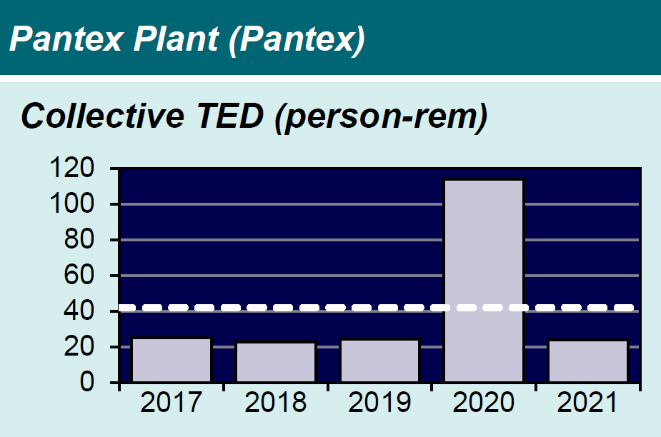
Continuity – Root Cause
DNFSB report to Secretary regarding dosimeter processing issues with Pantex and NNSS
Pantex system failure, sent dosimeters to backup processor NNSS, results were “off” due to calibration differences

Slide 6
Continuity – Root Cause
DNFSB report to Secretary regarding dosimeter processing issues with Pantex and NNSS
The report is generally favorable of DOELAP, but note a “weakness” in DOE-STD-1095-2018 that “exacerbated the challenges”
1095 and 1112 both contain provisions requiring sites to have a documented method for backup/continuity of ops. DNFSB issue is there is no requirement to periodically exercise those provisions
EHSS committed to revise the DOELAP standards to address the DNFSB’s concerns
1095 has been revised and will be formally issued soon
Clarification on minimum expectations for continuity

Slide 7
DOE-STD-1095-20XX Revision Continuation of Accredited Activities
4.2 Continuation of Accredited Activities
A program shall have a documented plan to ensure continuation of accredited activities in the event of a temporary and unexpected loss of capability, up to 6 months. The documented plan shall include methods for maintaining redundant accredited measurement capabilities and methods for re- distribution of responsibilities following the loss of key personnel.
4.2.1 Redundant Measurement Capabilities
Programs shall identify measurement and testing equipment essential to maintain operation of key systems.
Programs that utilize duplicate measurement system capability for continuation of accredited activities shall:
Maintain calibration of measurement systems
Demonstrate equivalent performance to primary system
Identify responses to catastrophic loss (e.g., natural disaster, power surge, building fire).
Programs that utilize backup service providers shall have a documented agreement in place that includes processing equipment types, dosimeter types, accredited categories, and number of expected measurements. Backup service providers shall:
Maintain a DOELAP accreditation or vendor qualification per DOE-STD-1111, Department of Energy Laboratory Accreditation Program Administration
Have demonstrated acceptable performance in all accredited categories identified in the agreement
Perform blind testing of all relevant categories at a defined frequency after establishing the agreement.
Duplicate measurement systems and backup service provider capabilities shall be exercised at a frequency identified in the QAP to ensure dosimetry results are accurate, repeatable, and verifiable.
In the event backup service provider is required, the program will notify the DOELAP Senior Technical Manager prior to sending personnel dosimeters to the backup service provider.

Slide 8
DOE-STD-1095-20XX Revision Continuation of Accredited Activities
4.2.2 Unexpected Loss of Key Personnel
Key personnel are those who have assigned duties and functions necessary to implement the accredited program defined by this standard.
A plan shall identify key personnel and document methods for mitigation of the loss, until qualified replacements can be established. Examples may include staff reassignment (permanent or temporary), consultant agreement, or corporate reach back program.

Slide 9
Continuity and Radiobioassay
DOE-STD-1112-2019 4.2(h) A program shall have a documented plan for continuity of operations. This includes service contracts, in-house maintenance, spare parts capabilities, and unexpected loss of key personnel.
DOELAP recognizes that radiobioassay is quite different than external dosimetry
There will have to be some parallel to 1095

Slide 10
Continuity – in the meantime…
How to meet requirements
MOAs
On site backup
Alternative methods, emergency plans
Personnel cross training, corporate reach back, etc.
Concern
No plan, agreement not renewed within accreditation period (if utilizing backup agreement), spare parts or maintenance capability not in place.
Observation
Plan or agreement in place, not comprehensive, plans may lack detail

Slide 12
4.6(d) Blind Testing Findings
XXX does not perform the In-vivo blind tests to validate the overall performance of the detector and document the frequency of monitoring. Furthermore, XXX does not test the In-vivo measurements with the interference common to the matrix being measured in the program. 4.6(d).
4.6(d) of DOE-STD-1112-2019: addressing Quality Improvements reads, in part, "Blind testing shall be conducted to validate the overall performance of the radiobioassay system and the frequency of monitoring shall be documented. Despite this requirement, YYY failed to conduct timely blind testing for both In-vivo and In-vitro measurements.
Blind QC samples are prepared in accordance with "Preparation of Radiobioassay Laboratory Blind Quality Control Samples. These QC samples are spiked with the same radioactive standards that are utilized for routine QC samples. The assessment team recommends getting a set of different standards of the same isotopes to act as an "external" check to make sure measurements and routine standards are validated. [4.6(d)]

Slide 13
Blind Testing
DOE-STD-1112-2019 4.6 (d) Blind testing shall be conducted to validate the overall performance of the radiobioassay system and the frequency of monitoring shall be documented. Blind testing samples that are submitted for analyses, over time, shall include samples that demonstrate accuracy, false positive, false negative and sensitivity evaluations. Blind testing samples shall contain chemical, matrix and radionuclide interferences common to the program’s routine samples. Procedures describing steps to be taken in the event that blind testing results are outside of pre-established criteria shall be documented.
DOE-STD-1095-2018, 4.7.2(e): Blind testing shall be conducted to validate the overall performance of the dosimetry system. The blind testing program shall consist of the use of dosimeters irradiated by NIST-traceable isotopic sources or x-ray beams to doses that are unknown to the processor. Exposures to blind test dosimeters shall include those sources and x-ray beams for which the program is accredited. Procedures describing steps to be taken in the event that blind testing results are outside of pre-established criteria shall be documented. Blind test dosimeters should be incorporated into every dosimeter exchange.

Slide 14
Blind Testing
Bioassay labs have a wide variety of issues with accuracy, false positive, false negative, sensitivity levels
In vitro samples are relatively straightforward
Strategies for in vivo systems
Phantom library
Importance of blind testing
ANSI/HPS N13.30-2011 testing categories and levels
Sites’ oversight responsibility

Slide 15
Blind Testing - Generalities
Activity levels
Accuracy – ANSI N13:30 2011 MTLs
Sensitivity – 2 to 3 times DL
False Positive – activity below DL
False Negative – DL – MDA with interfering nuclides
Acceptance criteria of the tests being performed – probably evaluated one sample at a time
Accuracy – bias with +/-30% and statistically identical at 2 sigma
Sensitivity – statistically identical at 3 sigma
False Positive – statistical zero at 3 sigma
False Negative – statistically positive at 3 sigma

Slide 16
What does DOELAP expect?
DOE-STD-1112-2019, 4.6(d): Blind testing shall be conducted to validate the overall performance of the radiobioassay system and the frequency of monitoring shall be documented. Blind testing samples that are submitted for analyses, over time, shall include samples that demonstrate accuracy, false positive, false negative and sensitivity evaluations. Blind testing samples shall contain chemical, matrix and radionuclide interferences common to the program’s routine samples. Procedures describing steps to be taken in the event that blind testing results are outside of pre-established criteria shall be documented.
This is meant to be useful to the site
The site defines the program
There is no “one program to rule them all”
Each DOE site is responsible for the dose assigned (or not) to its workers

